Slide 1
Weathering

Slide 2
By the end of this lesson, you should be able to:
Identify the causes of physical weathering.
Identify the causes of chemical weathering.
Describe how physical and chemical weathering differ from one another.
Explain the factors that affect weathering.

Slide 3
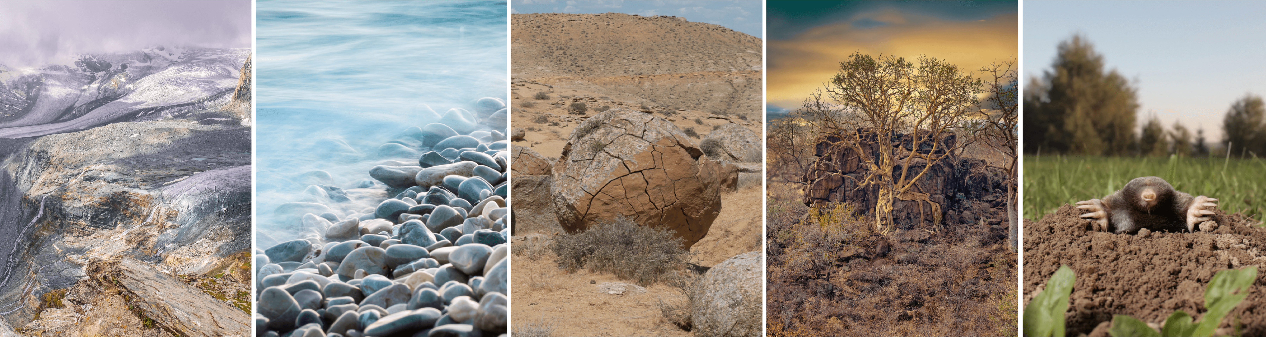
Physical weathering, also called mechanical weathering and disaggregation, causes rocks to crumble.
This type of weathering only changes the physical structure of the rock, i.e. its shape and size.

Slide 4
Frost wedging, or “ice wedging”or “cryofracturing” is one form of physical weathering.
Water, in either liquid or solid form, is often a key agent of physical weathering.
Frost action is the main form of physical weathering in a climate that regularly cycles above and below freezing point (e.g. in many parts of Canada).
Frost wedging is the process by which water seeps into the cracks of a rock, expands upon freezing and thus enlarges the cracks. If this cycle continues frequently, the rock breaks into pieces.

Slide 5
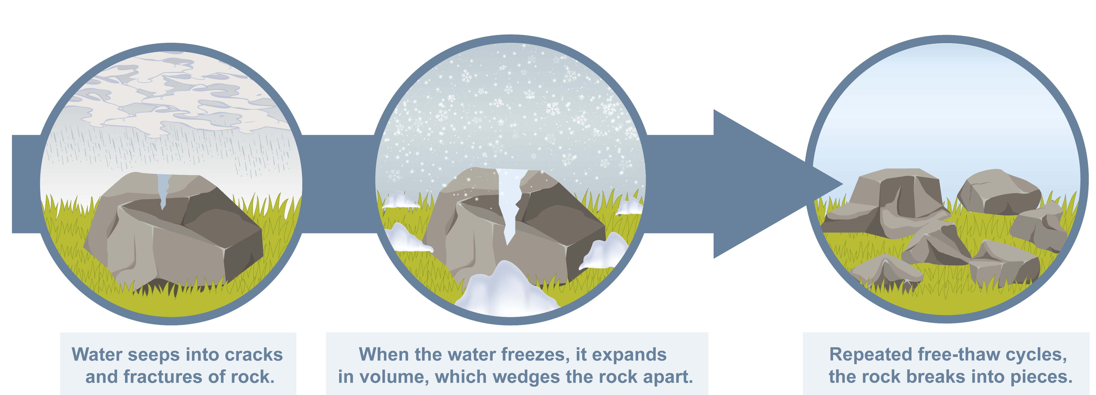

Slide 6
Abrasion, another form of physical weathering, is when one rock bumps against another rock.
Abrasion can take many forms, such as:
Gravity causing abrasion as rocks tumble down a mountainside or cliff.
Strong winds carrying pieces of sand can cause abrasion to rock surfaces (known as "sandblasting").
Running or moving water causing abrasion as particles in the water collide and bump against one another.

Slide 7
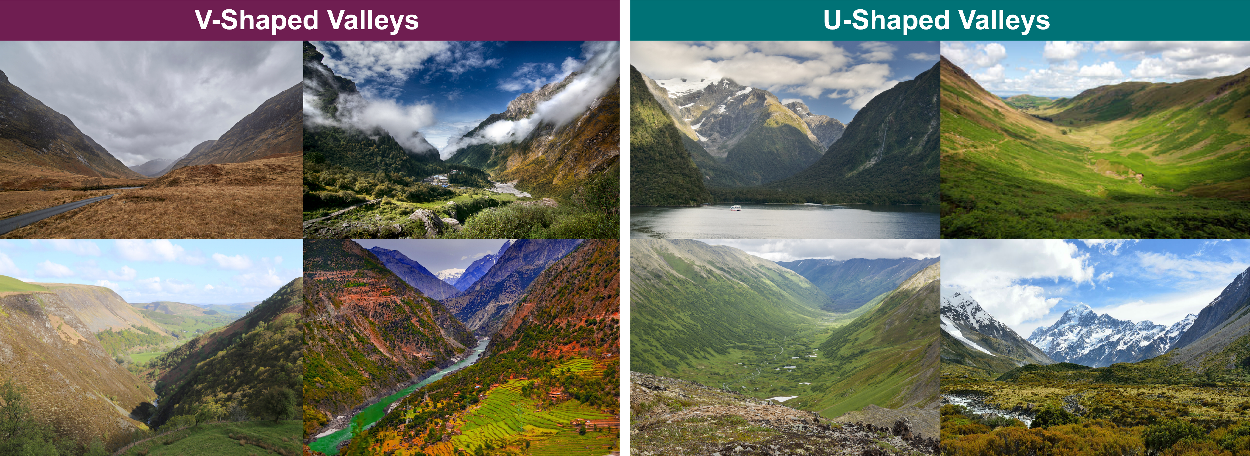
As mentioned before, running water causes abrasion to rocks. This is certainly the case with rivers!
River water continuously running over rocks causes them to gradually wear away. Over geological time, this process creates a “V” shaped valley.
Glaciers can be described as a type of river, except made of ice! They move very slowly from the tops of mountains, grinding and scraping the rock to eventually form a “U” shaped valley.

Slide 8
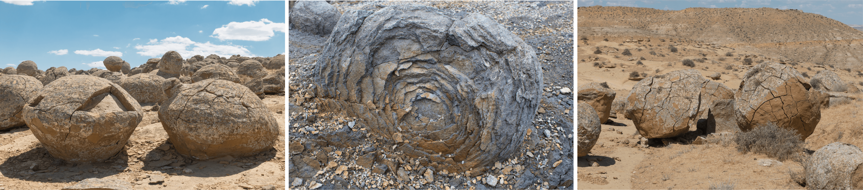
Exfoliation is another form of physical weathering that affects massive rocks such as granite or basalt.
Rocks expand in size from heating during the day and then contract from rapid cooling at night. This expansion-contraction causes separation of thin slabs of rock from large blocks of rock at the surface. This process is commonly referred to as "onion skin "weathering" (as seen in the images below).

Slide 9
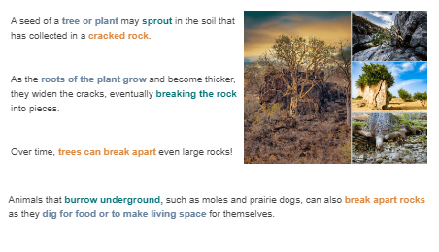
Plants and animals can also do the work of physical weathering.

Slide 10
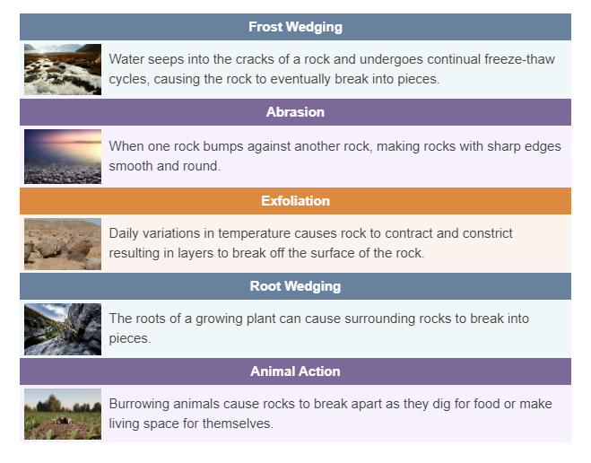

Slide 11
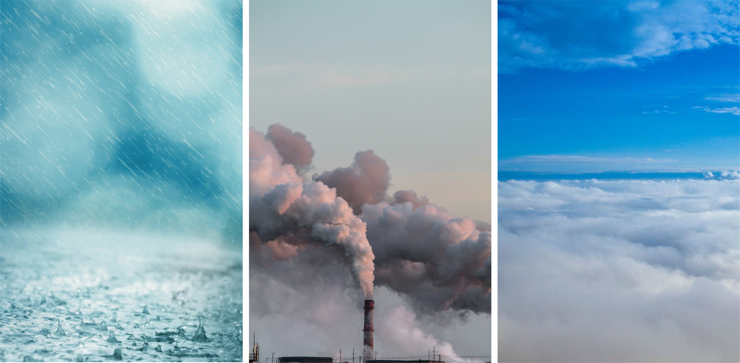
Chemical weathering is caused by water and other chemicals reacting with a rock to change its chemical composition.
There are many types of chemical weathering, as there are many agents of chemical weathering.
For the purpose of this lesson, we will focus on water, carbon dioxide and oxygen as the important agents of chemical weathering.

Slide 12
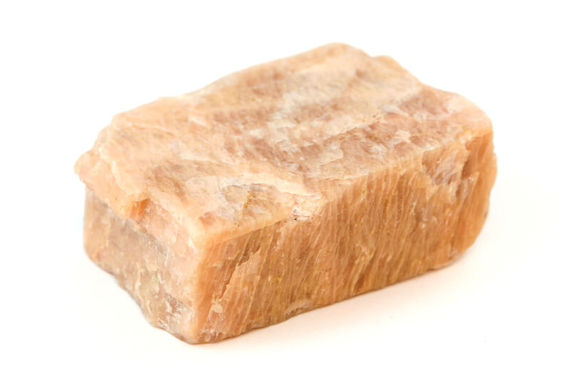
When a chemical reaction occurs between a chemical compound and water, this is called hydrolysis.
When this reaction takes place, water dissolves ions from the minerals and carries them away. These elements are said to have undergone leaching.
Through hydrolysis, a mineral such as potassium feldspar is leached of potassium and changed into a clay mineral.

Slide 13
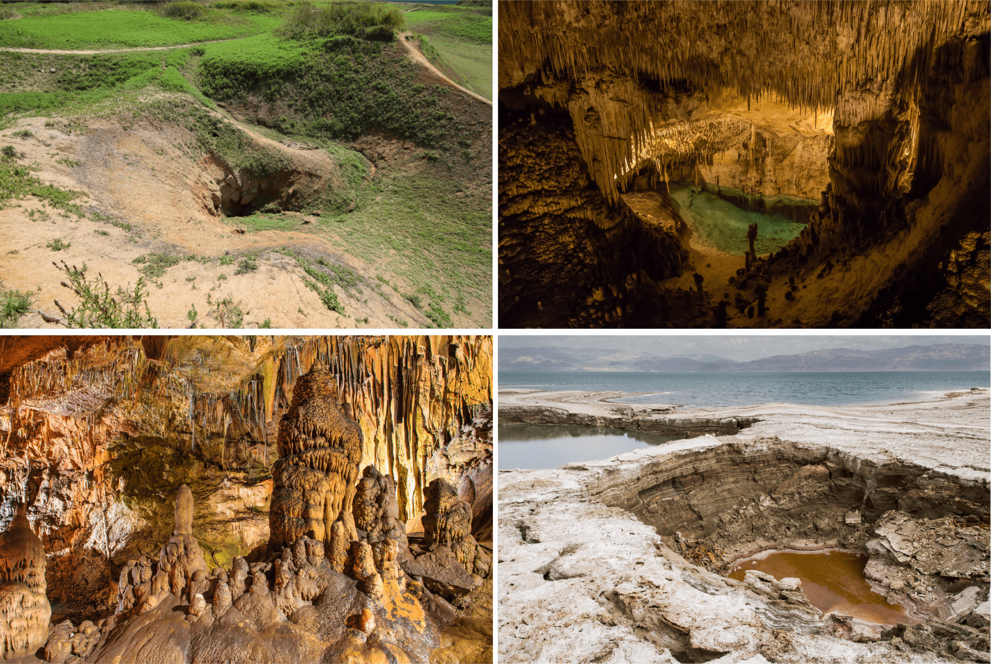
Carbon dioxide from the air or soil sometimes combines with water in a process called carbonation.
This produces a weak acid, called carbonic acid, that can dissolve rock. Carbonic acid is especially effective at dissolving limestone.
When carbonic acid seeps through limestone underground, it can open up huge cracks or hollow out vast networks of caves.

Slide 14
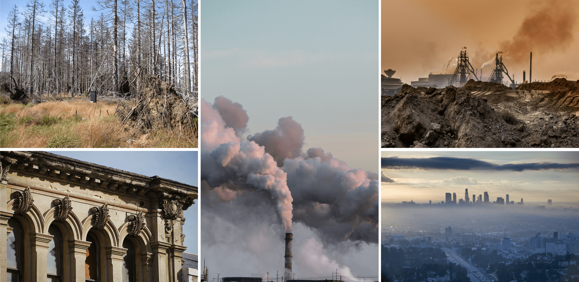
Pollutants, such as sulfur and nitrogen, from fossil fuel burning, create sulfuric and nitric acid.
Sulfuric and nitric acids are the two main components of acid rain, which accelerate chemical weathering.
Acid rain reacts with rocks to change their chemical composition. Marble, made up of calcium-rich particles, is a substance that is easily dissolved by acid rain!

Slide 15
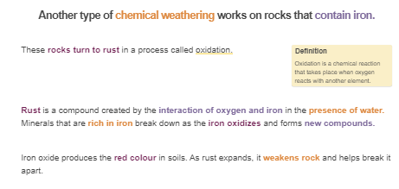

Slide 16
Just like physical weathering, plants and certain organisms can also be responsible for chemical weathering.
As plant roots take in soluble ions as nutrients, certain elements are exchanged between the plant and soil. Over time, this can cause chemical weathering to surrounding rocks.
A specific group of organisms called lichens can actually eat rocks! Lichens produce acid to dissolve rocks and obtain elements such as phosphorus.

Slide 17
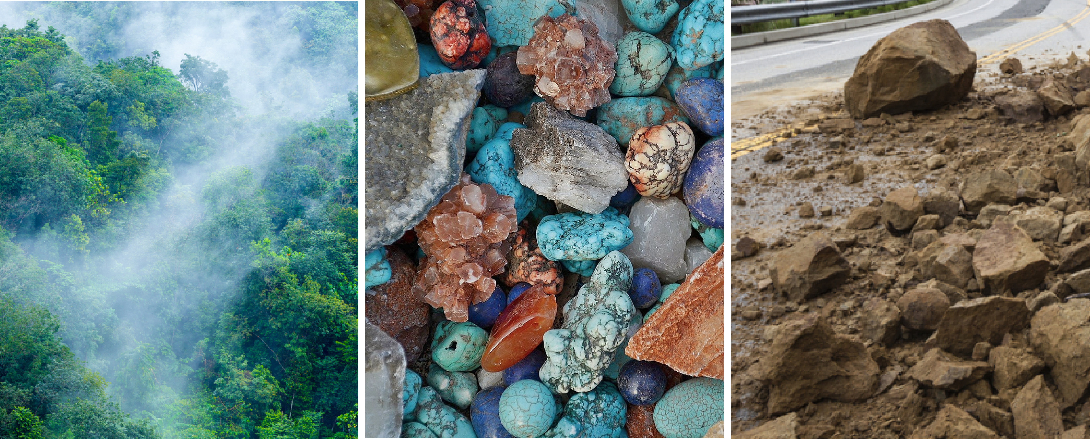
The rate of weathering depends on several factors.
These factors include:
Climate
Rock and mineral type
Surface area

Slide 18
A region’s climate strongly influences weathering.
The climate of any region is determined by the temperature and amount of precipitation it receives. Essentially the “climate” is the weather averaged over a long period of time.
A cold, dry climate will produce the lowest rate of weathering. In contrast a warm, wet climate will produce the highest rate of weathering.

Slide 19
Different rock types weather at different rates.
Specific types of rock are resistant to weathering, such as igneous rocks like granite. These rocks weather slowly because it is hard for water to penetrate them.
Other rock types, such as the sedimentary rock limestone, are easily weathered because they dissolve in weak acids. Since there are spaces between the grains of sedimentary rocks, water is able to penetrate more easily and cause greater weathering.

Slide 20
The final factor that can influence the rate of weathering is the surface area of a rock.
Surface area refers to how much of the rock is actually exposed to the elements (i.e. wind and rain).
Large rocks have a small surface area to volume ratio, and so weather at a slow rate.
Small rocks have a large surface area to volume ratio, and so weather at a fast rate. For example, water is able to get into the cracks of small rocks to accelerate chemical weathering.

